Slide 1
Annielytics Brand Extension

Slide 2


INTRO
OUTRO
Motion: Logo to animate on, echo elements, then sound wave
Motion: Logo to animate on, the three line will appear like an equalizer

Slide 3
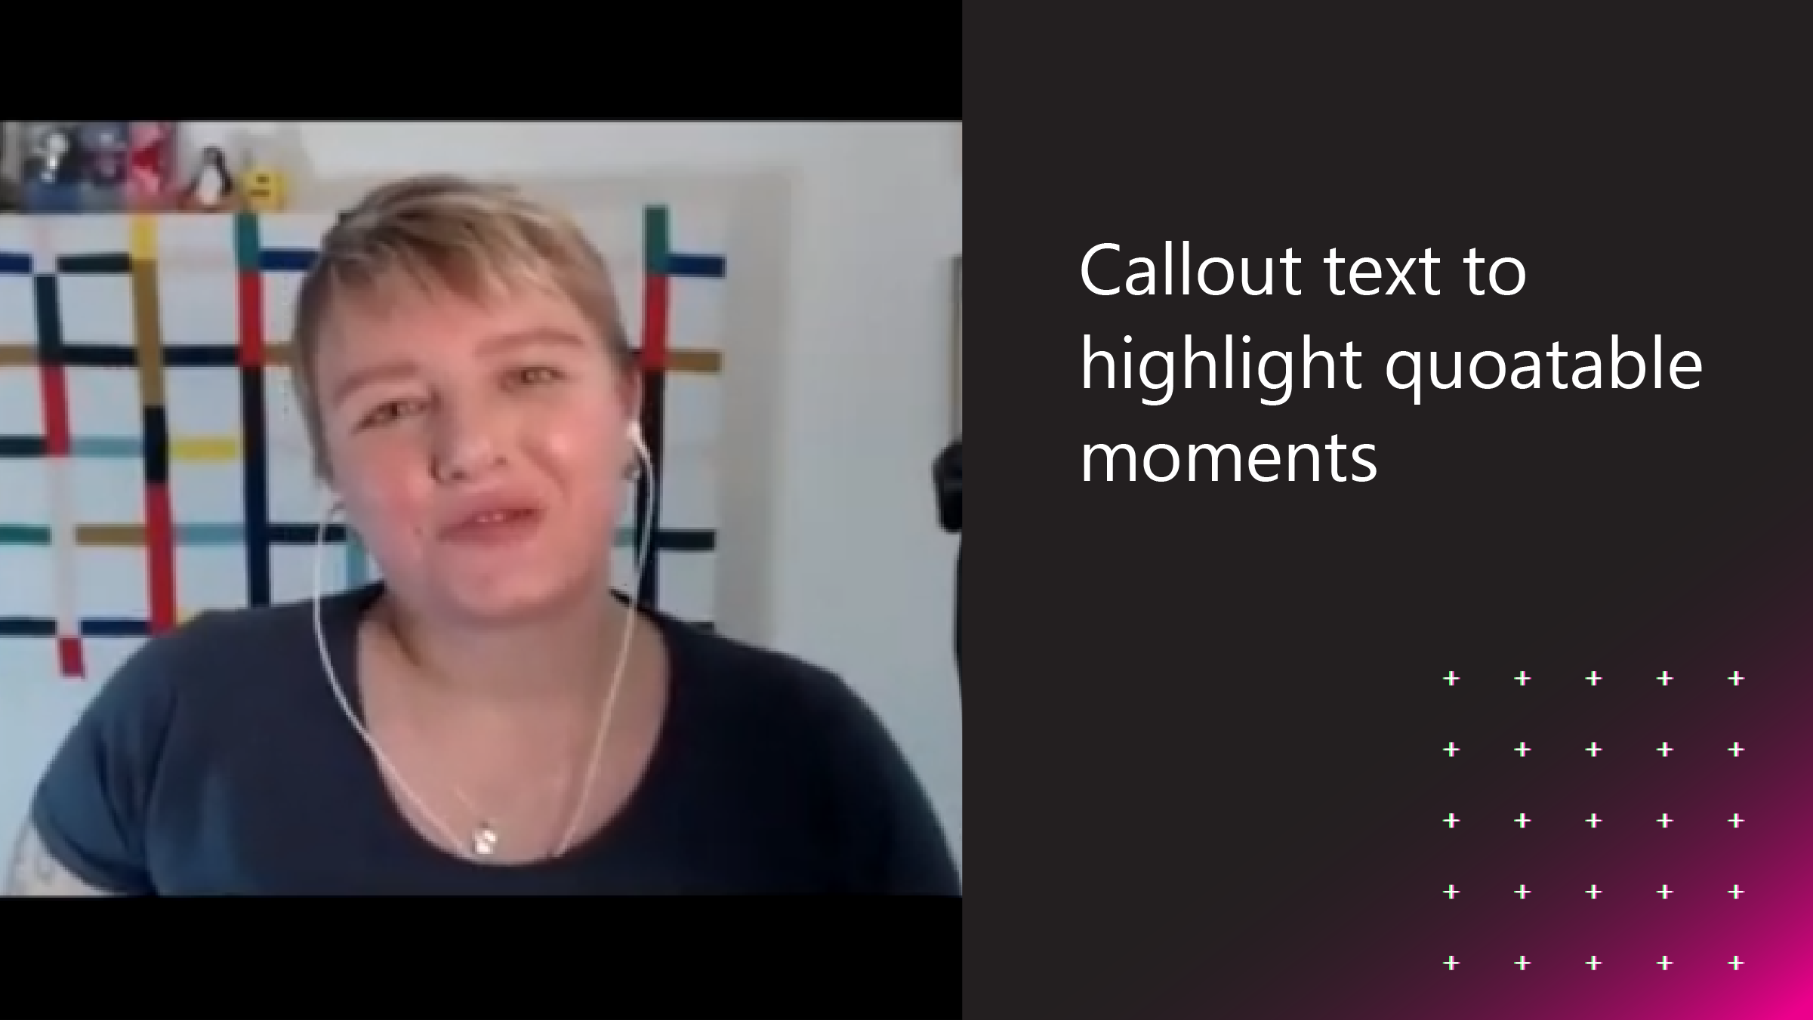
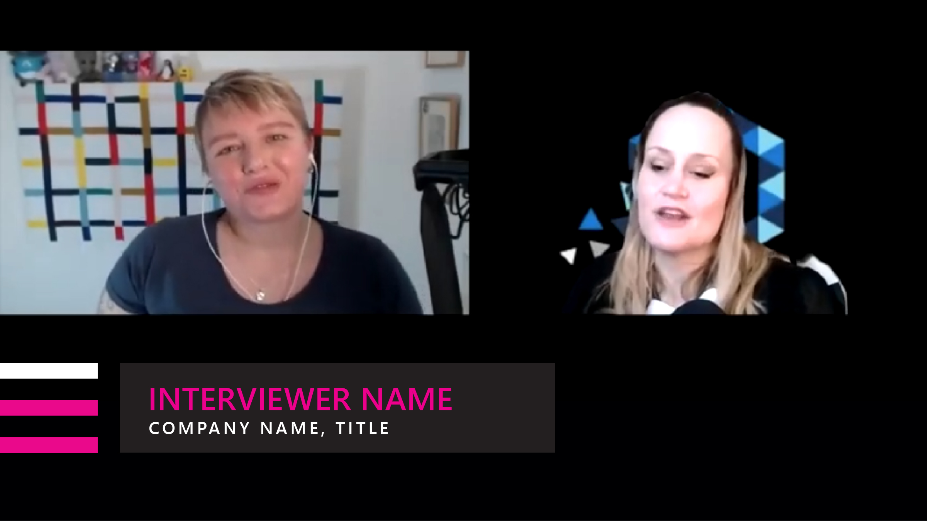
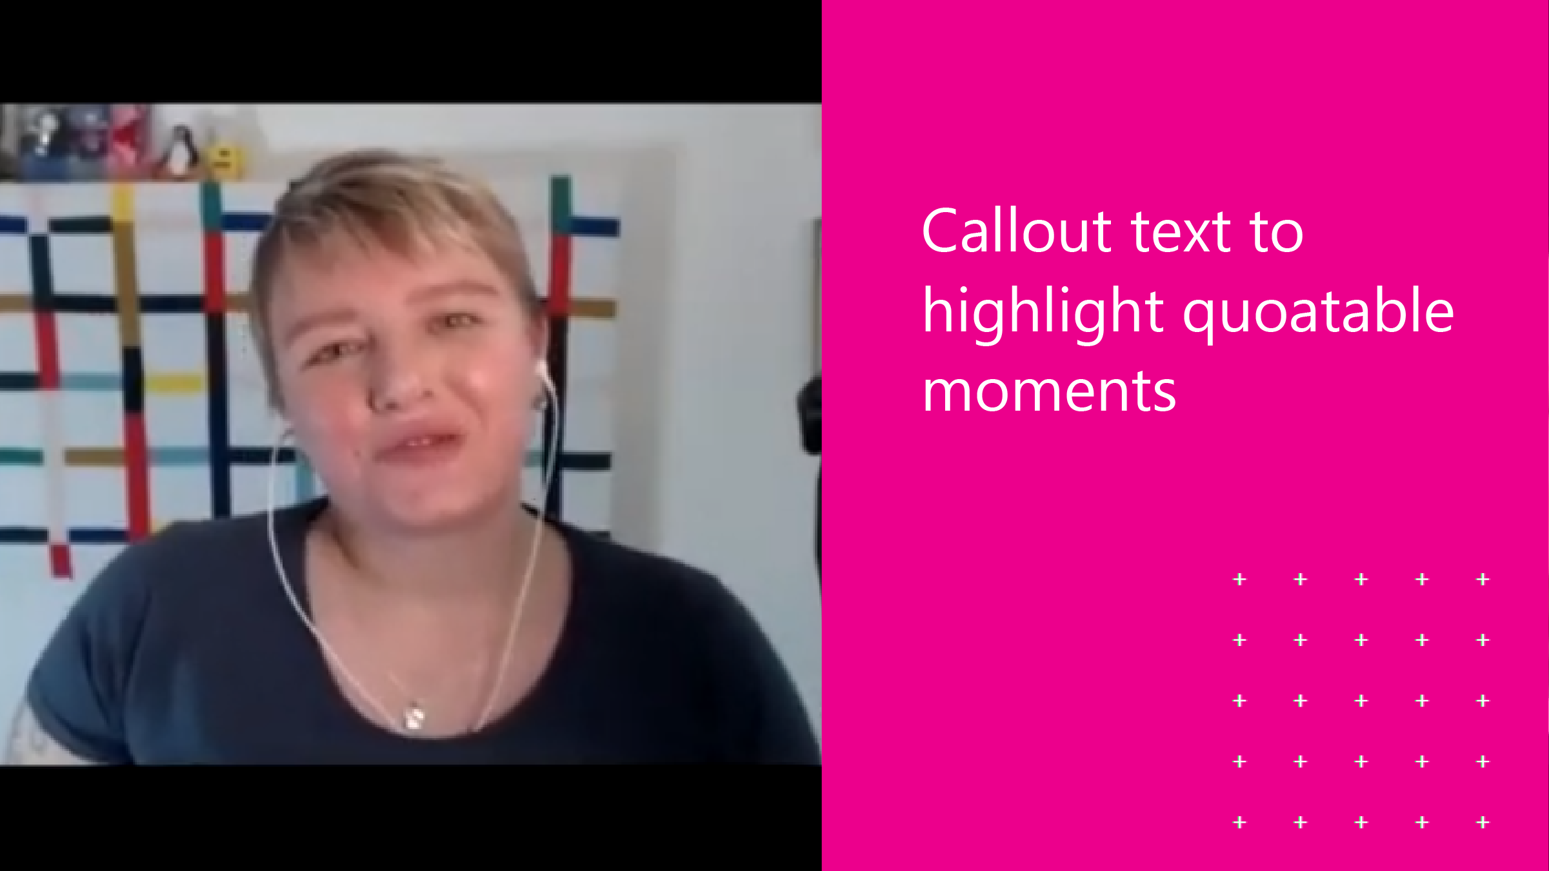
QUATABLE CALLOUTS - TEMPLATE
LOWER THIRDS
Motion: Three bars appear on like an equalizer, name, company and title to appear
Motion: Kinetic text to appear when the speaker says something particularly notable

Slide 4


TITLE CARD: INTERVIEW
TITLE CARD: TOPIC/TEXT ONLY
Motion: Episode text to animate on, subtle movement in the sound wave
Motion: Episode text to animate on, subtle movement in the sound wave

